Slide 1
Ch.3 Metrology for Time-Domain Spectrometers
Lee Jong Geon

Slide 2
Contents
Performance Parameters: Sensitivity, Resolution, Precision, Accuracy, Dynamic Range, and Signal-to-noise Ratio
Dynamic Range and Signal-to-Noise Ratio of Terahertz Time-Domain Spectrometers
System Performance Limits Due to Dynamic Range and Signal-to-Noise Ratio
Sources of Random Noise
Systemic Errors
Terahertz Beam Profile

Slide 3
Performance Parameters:
Sensitivity, Resolution, Precision, Accuracy, Dynamic Range, and SNR

Slide 4
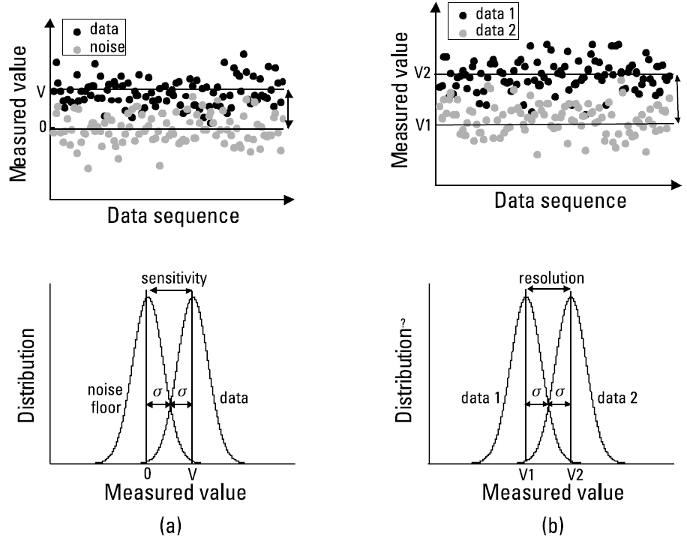
1. Performance Parameters: Sensitivity, Resolution, Precision, Accuracy, Dynamic Range, and SNR
Type A uncertainty: Random uncertainties
➔ averaging
Type B uncertainty: Systematic uncertainties
➔ cannot be analyzed with statistics
Sensitivity: The minimum measurable value
Resolution: The minimum measurable difference between two value
Precision: The numerical value of measurement reproducibility
Ratcliffe, C., and Ratcliffe, B., Doubt-Free Uncertainty In Measurement: An Introduction for Engineers and Students, Cham: Springer, 2015.

Slide 5
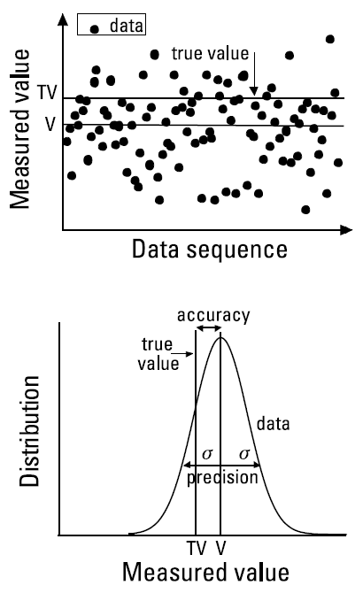
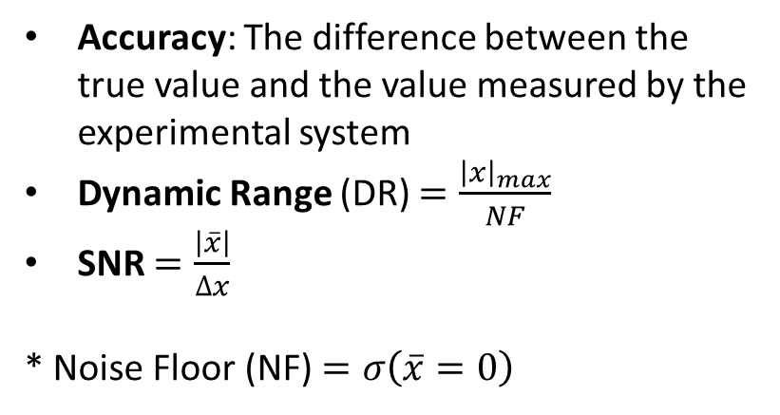
1. Performance Parameters: Sensitivity, Resolution, Precision, Accuracy, Dynamic Range, and SNR
Accuracy: The difference between the true value and the value measured by the experimental system
Dynamic Range (DR) $=\frac{{\left|x\right|}_{max}}{NF}$
SNR $=\frac{\left|\overline{x}\right|}{∆x}$
* Noise Floor (NF) $=σ\left(\overline{x}=0\right)$

Slide 6
DR and SNR of Terahertz TDS

Slide 7
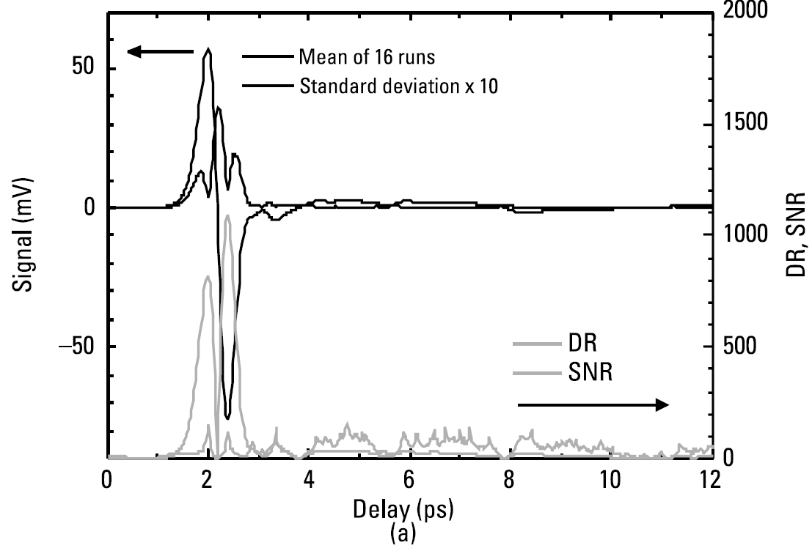
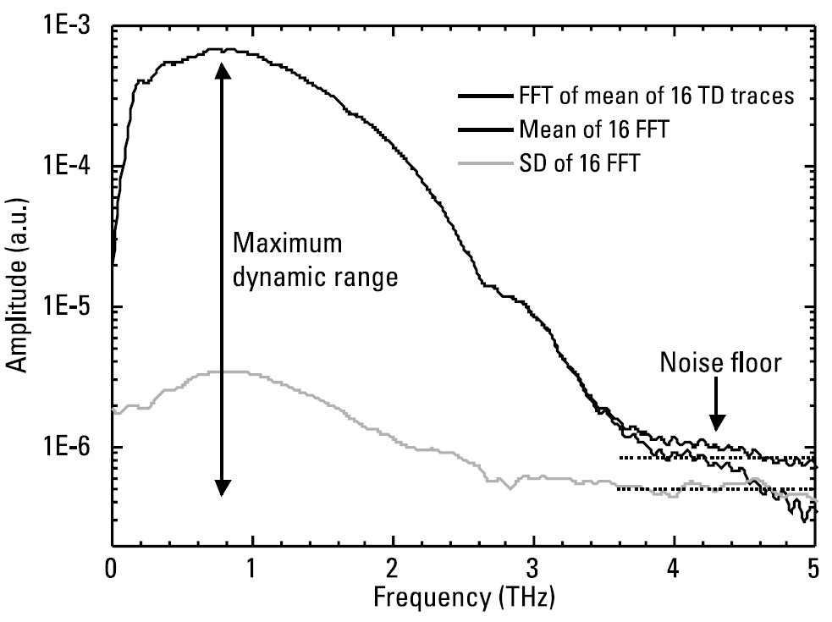
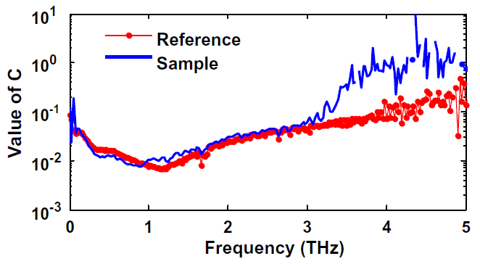

2. DR and SNR of Terahertz TDS
SNR and DR in time-domain
SNR fluctuate strongly and irregularly
No meaningful information
DR follow the absolute value of the signal
$$σ\left(ν\right)=C\left[E\left(ν\right)−h\right]+h$$
Tripathi, S. R., et al., “Pratical Method to Estimate the Standard Deviation in Absorption Coefficients Measured with THz Time-Domain Spectroscopy,” Opt. Commun., Vol. 283, 2010.

Slide 8
System Performance Limits
Due to DR and SNR

Slide 9
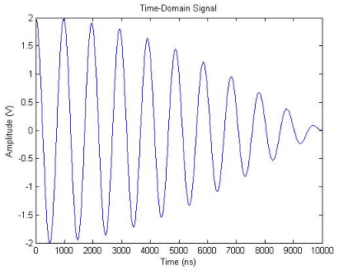
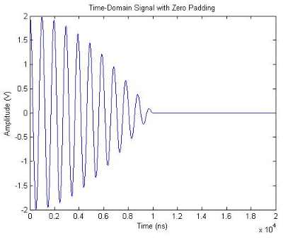
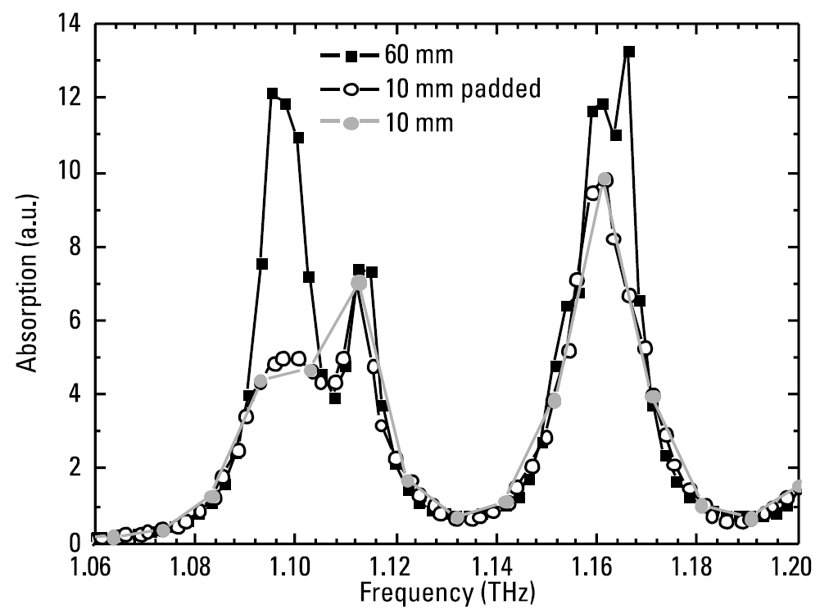
3.1 Frequency Resolution
Zeor-padding
The frequency resolution of a time-domain spectroscopy may be improved by zero-padding. However the additional data points arising from a string of zeros carry no additional information
Hilbert, S. (n.d.). FFT Zero Padding. Retrieved March 15, 2018, from http://www.bitweenie.com/listings/fft-zero-padding/

Slide 10
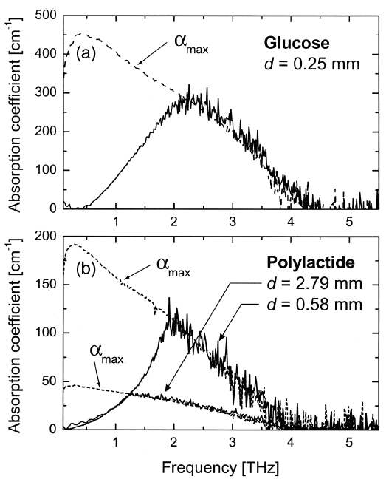
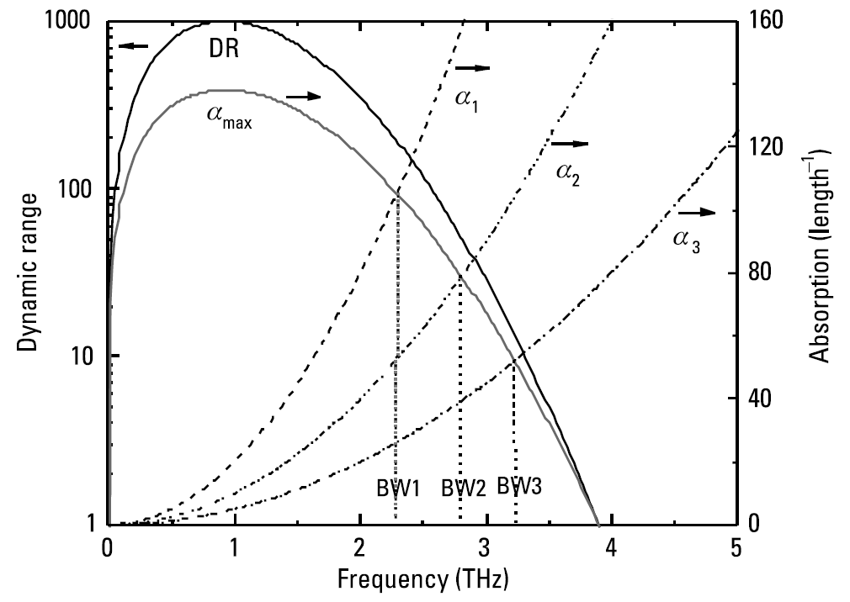
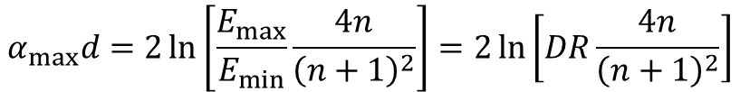
3.2 Meqsurement Bandwidth
In the frequency domain, the dynamic range places limits on the bandwidth, maximum measurable absorption, and usable sample thickness.
$$α_{max}d=2\ln\left[\frac{E_{max}}{E_{min}}\frac{4n}{{\left(n+1\right)}^{2}}\right]=2\ln\left[DR\frac{4n}{{\left(n+1\right)}^{2}}\right]$$
Jepsen, P. U., and B. M. Fischer, “Dynamic Range in Terahertz Time-Domain Transmission and Reflection Spectroscopy,” Opt. Lett., Vol. 30, 2005.

Slide 11
Sources of Random Noise

Slide 12
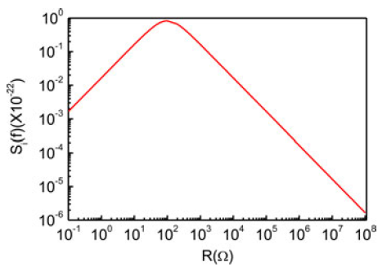
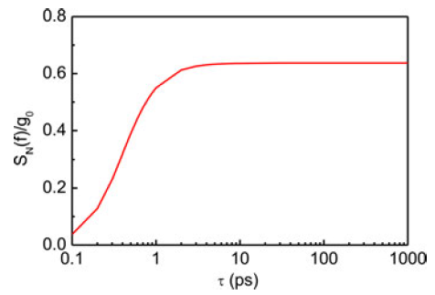




4.1 Amplitude
Mechanical noise sources
Vibrations, air currents in the beam paths, particulates in the air along the beam path, and thermal deformations.
Thermal noise
When the photoexcited carriers move across the surface, the thermal motion of carriers will cause a fluctuation of electrodynamic potential across the PC antenna.
$$L\frac{di}{dt}+Ri=H(t)$$
$$S_{T}\left(ω\right)=\frac{4kTR}{R^{2}+ω^{2}L^{2}}$$
Genration-recombination noise
The fluctuation of carriers can be described as
$$\frac{d∆N}{dt}=−\frac{∆N}{τ}+H(t)$$
$$S_{N}\left(ω\right)=\frac{4g_{0}τ^{2}}{1+ω^{2}τ^{2}}$$
Hou, L., W. Shi, and S. Chen, “Noise Analysis and Optimization of Terahertz Photoconductive Emitters,” IEEE J. Selected Topics Quantum Electronics, Vol. 19, 2013.

Slide 13
4.2 Phase
Electronical noise
Phase Jitter
Imperfect synchronicity between the terahertz signal and detector triggrting
Mechanical noise
Optical chopper (rise time, fall time)
Vibration and air currents

Slide 14
Systematic Errors

Slide 15
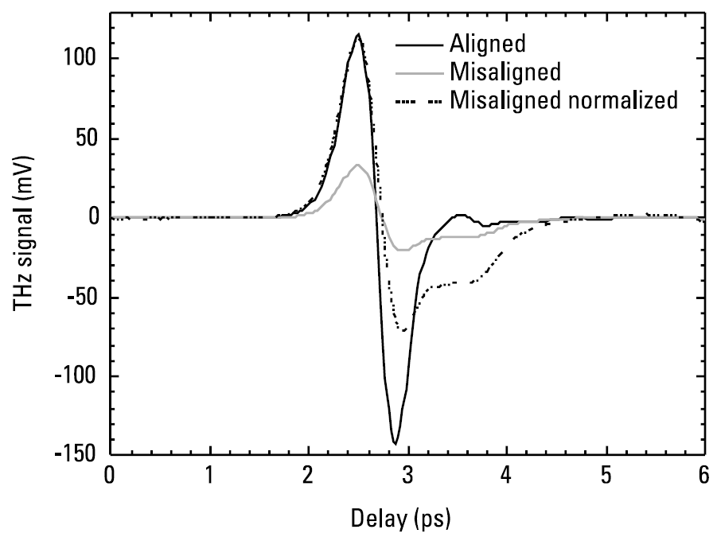
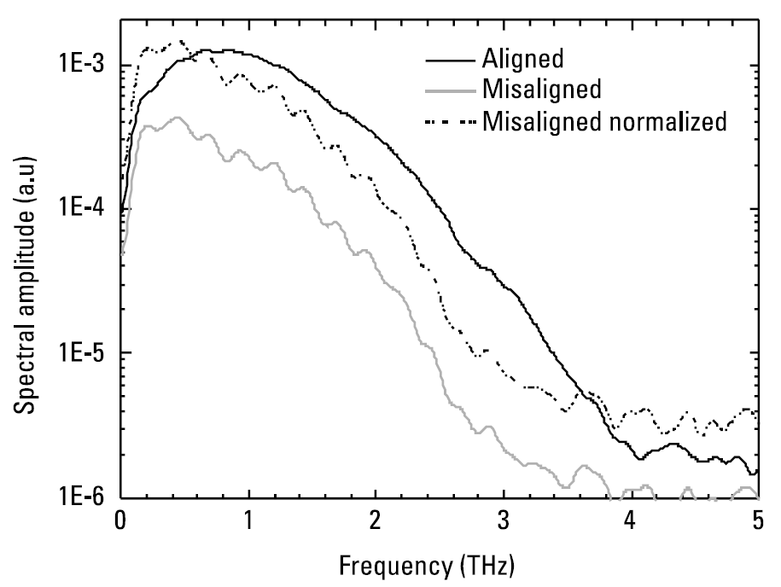
5.1 Alignment Errors
Misalignment not only reduces the signal, but also distrots the profile of the time-domain trace, leading to corresponding distortions in the spectral profile and a reduction in the available bandwidth.

Slide 16
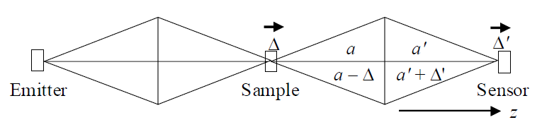
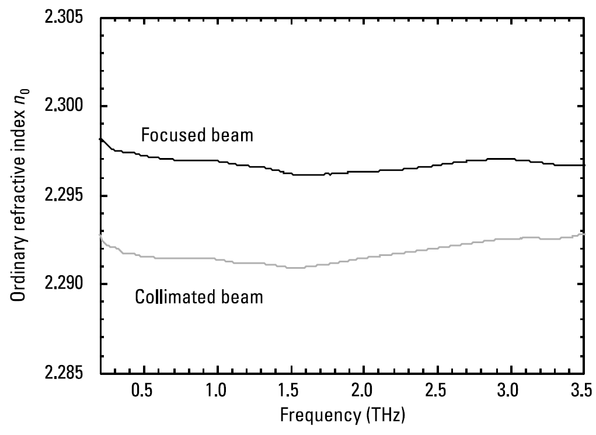
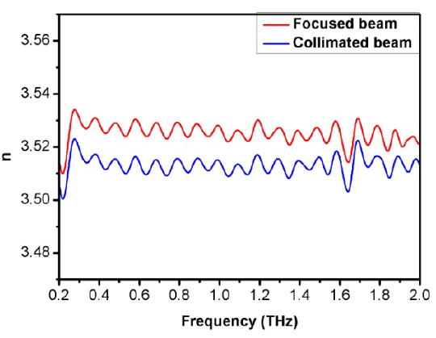
5.2 Focal Plane Defocusing
If the beam wavefront is substantially distorted by the presence of a dielectric object at tits waist, it will disturb beam propagation and especially its refocusing and terahertz-probe overlap at the detector.
Choi, D., et al., “Focused Beam Effect on Measuring Precise Optical Parameters of Liquid Water with Terahertz Time Domain Spectroscopy,” 2011 36th Onternational Conference on Infrared, Millimeter and Terahertz Waves (IRMMW-THz), October 2011.

Slide 17
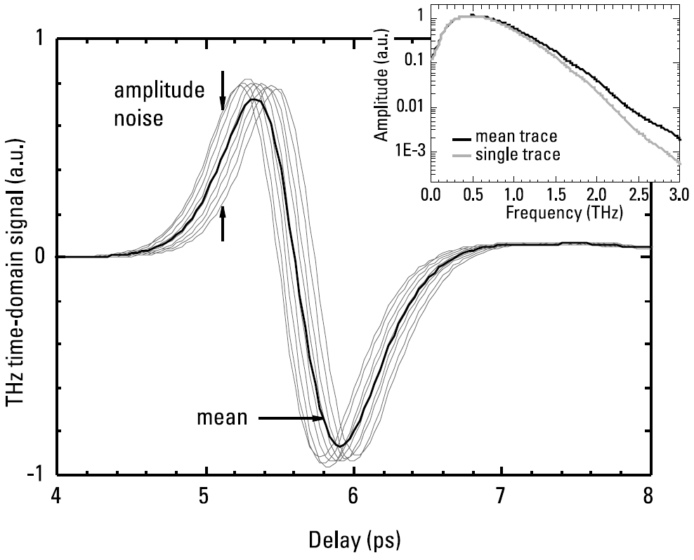
5.3 Delay Line Errors
Misalignment not only reduces the signal, but also distorts the profile of the time-domain trace, leading to corresponding distortions in the spectral profile and a reduction in the available bandwidth.

Slide 18
Terahertz Beam Profile

Slide 19
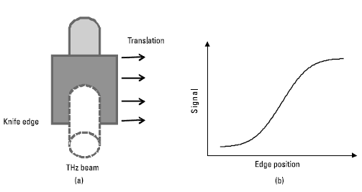
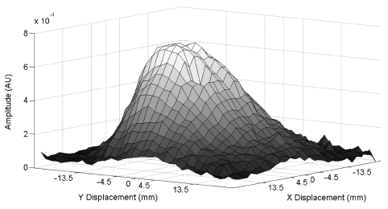
6. Terahertz Beam Profile
The diameter and profile of terahertz beams at various points in an time-domain spectroscopy may need to be measured.
System characterization
To verify and optimize system alignment
To check the spot size for imaging or for studying small samples
To observe effects of optical components
To test pieces inserted in the beam path
Knife-edge test

Slide 20
References
Ratcliffe, C., and Ratcliffe, B., Doubt-Free Uncertainty In Measurement: An Introduction for Engineers and Students, Cham: Springer, 2015, pp. 9-18.
Tripathi, S. R., et al., “Pratical Method to Estimate the Standard Deviation in Absorption Coefficients Measured with THz Time-Domain Spectroscopy,” Opt. Commun., Vol. 283, 2010, pp. 2488-2491.
Hilbert, S. (n.d.). FFT Zero Padding. Retrieved March 15, 2018, from http://www.bitweenie.com/listings/fft-zero-padding/
Jepsen, P. U., and B. M. Fischer, “Dynamic Range in Terahertz Time-Domain Transmission and Reflection Spectroscopy,” Opt. Lett., Vol. 30, 2005, pp. 29-31.
Hou, L., W. Shi, and S. Chen, “Noise Analysis and Optimization of Terahertz Photoconductive Emitters,” IEEE J. Selected Topics Quantum Electronics, Vol. 19, 2013, p. 8401305.
Choi, D., et al., “Focused Beam Effect on Measuring Precise Optical Parameters of Liquid Water with Terahertz Time Domain Spectroscopy,” 2011 36th Onternational Conference on Infrared, Millimeter and Terahertz Waves (IRMMW-THz), October 2011, pp. 1-7.

